Slide 1

Notes:
Trainer has to introduce self and give an introduction about FACE

Slide 2

STRESS INTERVIEW
Notes:
Today, we are going to look at “Stress Interview”.

Slide 3
Agenda
What is Stress Interview?
Why are Stress Interviews conducted?
Types of Stress Interviews
Example Stress Interview questions
How to prepare for Stress Interview?
More example questions
Recap
Course
Notes:
These are the topics that we are going to cover in this session.

Slide 4
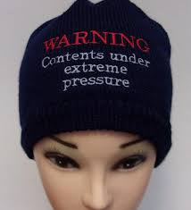
What is Stress Interview?
A stress interview is a tactic used to put candidates under extreme pressure.
It is designed to test your ability to think on your feet, respond appropriately in difficult situations and stay calm in a pressurized environment.
Notes:
When using the stress interview technique, employers are looking to see how candidates would handle things like workplace conflict, abusive customers and work overload. They are intentionally provoking you to assess your psychological and physical responses to stressful situations.

Slide 5


Why are Stress Interviews conducted?
Employers will use these interviews to make sure that candidates have the right attitude and the emotional capability to handle these taxing environments.
Notes:
Companies that adopt the stress interview technique are usually those that operate in fast-paced, pressurized industries such as investment banking, or top-level customer services such as air travel or front-line public sectors.
While competency based interviews give you the opportunity to demonstrate your skills, knowledge and experience, stress interviews are designed to move you beyond the interview room and into the real world, where trying or confrontational situations may be a regular occurrence.
Stress interviews are usually carried out by experienced professionals, who adopt a number of strategies to gain a true reflection of your personality as a potential employee.
You may also be put through a stress interview if the role in question is one of high authority and responsibility.

Slide 6
Types of Stress Interviews
Dismissive Behavior
Intimidating or Rude Behavior.
Random Questioning
Aggressive Questioning
Difficult Hypothetical
Notes:
There are several types of Stress Interviews; employers may use any or all of the following techniques:
Dismissive Behavior: The interviewer may act uninterested in you and what you have to say. They may use body language and signals to suggest they have better things to do, such as constant clock-watching or sorting papers on their desk. They may act distracted or bored – looking around the room and purposefully avoiding eye contact.
Intimidating or Rude Behavior: The interviewer may act in an inappropriate or hostile manner. Techniques include subjecting you to a long wait, talking abruptly, or answering phone calls mid-interview. They may ask challenging questions in a demeaning tone, interrupt you or ask you to constantly repeat yourself. In extreme stress interviews, you may be put in front of several interviewers who intimidate you in turn to see if you will ‘break’.
Random Questioning: Seemingly random questions are often used to assess how candidates think on their feet. Questions such as “What type of biscuit would you be and why?”, “What would you do with a million pounds?” and “How would you change the design of a clock?” are meant to test your problem-solving skills as well as giving away a little of your personality at the same time.
Aggressive Questioning: Typical stress interview questions are designed to prompt an emotional response and unnerve the candidate. You may be asked things like “Why were you fired from your previous role?”, “What do you think of my interview technique?” or “Why do you have extended periods of unemployment on your CV?”. These are not standard interview questions and are meant to be difficult to answer.
Difficult Hypothetical: You may be presented with an awkward hypothetical situation and asked to explain how you would deal with it. This could be to assess how you would handle workplace conflict (“What would you do if you found a co-worker cheating on their expenses?”) or how you would deal with confrontational situations (“You and your colleagues have just been physically threatened by an extremely aggressive customer. How do you react?”).

Slide 7

Example Stress Interview Questions
Notes:
Stress interview questions can be similar to those asked in behavioral or situational interviews. However, in this case, they are purposefully worded in such a way as to make you uncomfortable – and often delivered in a much more aggressive manner.
They are meant to put you on the spot, confuse or frustrate you.
They can be incredibly difficult to answer, but remember, how you react is just as important, if not more so, than the answer you give.

Slide 8
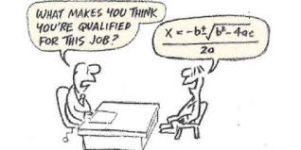
Aggressive Questioning
“What makes you think you’re qualified for this job?”
Notes:
Trainer has to ask this question and get the responses. The answer for this question is on the next slide.
It is only a model to answer this type of question. The answer may vary from person to person.

Slide 9
Aggressive Questioning
Example answer:
“The key responsibility of this role is to provide exceptional customer service, no matter the circumstances. In my previous role, I was often faced with aggressive behaviour. It was a learning curve at first, but experience has taught me that this type of behaviour usually stems from frustration and is best solved through patience and understanding.”
Finish your response with an example of when and how you resolved a tense situation.
Notes:
Trainer to orient the students on the below point and then discuss on the answer.
The key point here is that the interviewer already knows your qualifications and work history. They would not be talking to you if they thought them inadequate.
What they’re looking for in your response is a confidence in your own abilities.
Think of key personality traits that show your suitability to the role and give examples of these traits in action.

Slide 10
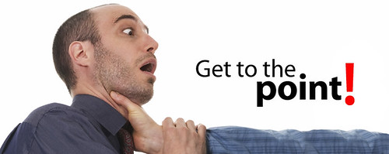
Dismissive/Rude Questioning
“You lost me halfway through. Could you start again and get to the point this time?”
Notes:
Trainer to ask the students and get the response.

Slide 11
Dismissive/Rude Questioning
Example answer:
“I’d be happy to talk you through my response again. Is there a particular point you’d like me elaborate on?”
Notes:
Trainer has to orient the below points and then discuss the answer.
This type of question is designed to shake your confidence and test your patience.
Don’t backtrack on your previous answer. The interviewer is looking for you to calmly repeat yourself, stand by your original response and provide clarification on anything that may be unclear.
Don’t be afraid to ask if they have any questions. This will show that you are open to their frustrations and willing to work through them.

Slide 12

Random Questioning
“What would you change about the design of a post box?”
Notes:
Trainer to ask the students and get the response.

Slide 13
Random Questioning
Example answer:
“We’re seeing the closure of a lot of local post offices so I’d look at bringing the post box into the digital age to replace some of the more basic services lost – such as recorded delivery and the ability to weigh larger envelopes and purchase the appropriate postage.”
Notes:
Trainer has to orient the below points and then discuss the answer.
Random questions like these have no right answer. In asking them, the interviewer is assessing how you respond to being put on the spot.
They’re not looking for you to reinvent the wheel. They are looking for someone who can perform under pressure with sound reasoning.
The explanation behind your answer is more important than what, if anything, you would change, so be sure to share your thought process.

Slide 14
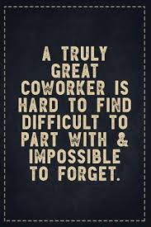
Difficult Hypothetical
“How would you deal with a co-worker who continually took credit for your ideas?”
Notes:
Trainer to ask the students and get the response.

Slide 15
Difficult Hypothetical
Example answer:
“I’ve often found that people who take credit for the ideas of others feel that their own voice is not being heard, so I would encourage them to work collaboratively at first. I would establish a common goal for us to work towards and make sure that all ideas and opinions are taken on board and discussed openly. In doing so, I would hope to establish a working relationship built on mutual respect and solid teamwork.”
Notes:
Trainer has to orient the below points and then discuss the answer.
Your answer here will demonstrate how you deal with workplace conflict and how much of a team player you are.
Try to show tact, diplomacy and a willingness to compromise.

Slide 16
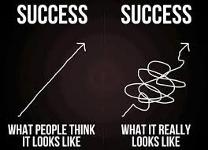
How to Succeed in Stress Interviews
Notes:
Trainer has to orient the points presented in the upcoming slides to “Succeed in Stress Interviews”.

Slide 17
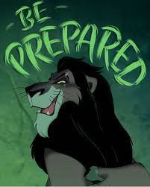
Be Prepared
Notes:
Be prepared. As they are designed to catch you off-guard, employers will rarely inform you in advance if they intend to conduct a stress interview. You will be better prepared to deal with them if you have done your homework. Find out everything you can about the company, its products or services, and its main competitors. If there are any company policies available online, take the time to read through them. Understanding the business ethics will help you respond accordingly to any related questions. Make sure you know the job description and person specification inside out. If you know the name of your interviewer, do a little research on their background as well.

Slide 18

Run through some example scenarios
Notes:
Run through some scenarios. If you think you may be subject to a stress interview, think of example questions relevant to the role and prepare your answers. Ask a friend or family member to help you run through these and practice your responses out loud.

Slide 19
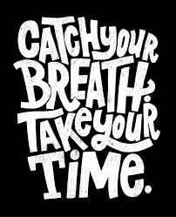
Take your time
Notes:
Take your time. When presented with stress interview questions, take some time to form your response. Don’t feel that you will antagonize the interviewer by asking for clarification. They are looking for how you would respond to stressful situations in real life, so making sure you understand exactly what is being asked of you is a good thing. This will also buy you more time to mentally prepare your answer.

Slide 20
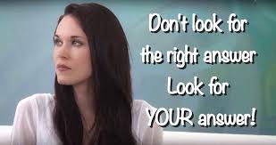
Don’t look for the ‘right’ answer
Notes:
Don’t look for the ‘right’ answer. Stress interview questions rarely have a right answer. The interviewer is not looking for a polished response, they are looking at how you deal with the pressure of the question. Demonstrate your problem-solving skills by providing detail on how you would or have approached a situation, instead of searching for what you think they want to hear.

Slide 21

Keep calm
Notes:
Keep calm. Never respond to aggressive behaviour in an aggressive manner. Your interviewer will try and provoke you; it’s important to recognize this and stay calm. Be aware of your movements. We’re often influenced by the actions of those around us, so if your interviewer adopts intimidating or dismissive body language techniques, be sure not to mirror them. Keep yourself open at all times.

Slide 22
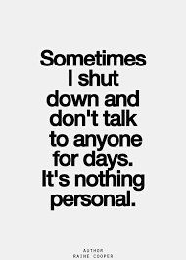
Don’t take it personally
Notes:
Don’t take it personally. A stress interview is not an attack on you as an individual. It is a technique used to demonstrate how you respond under pressure. If faced with harsh questioning or behaviour, remind yourself that it is a tactic and you should not take it to heart.

Slide 23
Remain positive
For example,
“Thank you for your time. That was incredibly tough but I feel it was a highly valuable experience for me.”
Notes:
Remain positive. Your interviewer will try to wear you down. Show them that you are resilient and remain upbeat throughout. No matter how hard the process has been, always try to end the interview with a positive closing remark. For example, “Thank you for your time. That was incredibly tough but I feel it was a highly valuable experience for me.”

Slide 24

Activity - Questionnaire
Sub-Topic (Example: name of college)
Notes:
Activity time : 15 minutes
Some of the example stress interview questions are given in the upcoming slides along with the answers in the next slides.
First, show the question and get the response from the students and then show the answers.
The answers are not fixed. Any clever answer is right. Appreciate the creativeness of the students and tell them they should be careful in handling stress questions.

Slide 25
Questions
What is your name? Why did your parents select this name specially for you?
Notes:
Trainer to elicit responses from the students.

Slide 26
Answers
Don’t tell a complete story behind your name. End up by saying something like “No any special reason as such, but may be my parents have considered the beginning letter to select my name.”
Notes:
Sample Answer.

Slide 27
Questions
What will you do if your boss shouts at you for any reason?
Notes:
Trainer to elicit responses from the students.

Slide 28
Answers
I will have to calm him down so as to help maintaining the decorum of the office. May be because of any untoward incidence, the boss goes under stress. I will try my level best to bring the situation to the normal level, irrespective of whether I have made some mistake or not.
Notes:
Sample Answer.

Slide 29
Questions
"If you caught a colleague cheating on his expenses, what would you do?"
Notes:
Trainer to elicit responses from the students.

Slide 30
Answers
Complaining will not solve the problem. So, I will suggest the decision maker to modify the system to prevent the cheating.
Notes:
Sample Answer.

Slide 31
Questions
What is the similarity in boss and monkey?
Notes:
Trainer to elicit responses from the students.

Slide 32
Answers
It seems to be very informal question. So I would prefer to be informal. So, according to me, a monkey gets benefited from the quarrel between cats (Ref. Story) and a boss makes his position by settling the disputes between subordinates.
Notes:
Sample Answer.

Slide 33
Questions
What is the characteristic of a dog that is similar to that of any boss?
Notes:
Trainer to elicit responses from the students.

Slide 34
Answers
(Smile) Please allow me to be informal for answering this informal question. I would say, “Both shout at you in the beginning, but once you prove your identity, they trust you.”
Notes:
Sample Answer.

Slide 35
Questions
Your resume suggests that you may be over-qualified or too experienced for this position. What's your opinion?
Notes:
Trainer to elicit responses from the students.

Slide 36
Answers
I feel that in the modern business world, seniority is related with your performance also, not only with qualification or experience. I am ready to make my career in such a professional atmosphere, which is available in your organization. I am a very open minded person with a learning attitude.
Notes:
Sample Answer.

Slide 37
Questions
As per your application, this job is the golden chance for you. So, you will be nowhere if you don’t get this. Isn’t it?
Notes:
Trainer to elicit responses from the students.

Slide 38
Answers
Immediately, I may feel nervous, but failure to get this job will be the first step for me towards success. I will also keep my candidature open for your organization in future, as I like to maintain relations.
Notes:
Sample Answer.

Slide 39
Questions
Why don’t you go for self employment?
Notes:
Trainer to elicit responses from the students.

Slide 40
Answers
I personally feel and I have also gone through some psychometric tests, where the results show that I can be a good intrapreneur as I can use my creativity in a very effective way for masses, if I work for others.
Notes:
Sample Answer.

Slide 41

RECAP ANYONE ?
Notes:
Trainer to ask anyone to re- cap.

Slide 42
RECAP ANYONE ?
What is Stress Interview?
Why are Stress Interviews conducted?
Types of Stress Interviews
Example Stress Interview questions
How to prepare for Stress Interview?
More example questions
Notes:
If any points were left out in the re- cap, Trainer to mention the same and then do a Final Re- Cap.

Slide 43

THANK YOU
Notes:
Trainer to thank the students saying that it was a good session and re- iterate the usefulness of the session.

